Slide 1
Estimated Payment Date for Supplier Connect
David Chi
2016-08-22

Slide 2
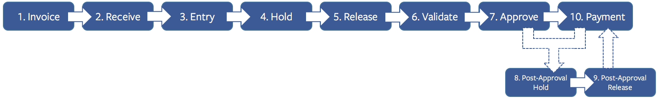
Invoice Payment
Invoice payment follows a multi-step process.

Slide 3
Predicting Future Payment Dates
Each step in the invoice payment process
entry, validation, approval, hold, payment, etc.
was modeled using a Decision Tree algorithm based on invoice parameters
vendor, amount, cost center, type, receipt requirement, etc.
and ~80,000 actual invoices since 2016-01-01.
Estimated payment date for any active invoice is calculated by summing the model predictions for each of the invoice’s remaining steps and adding to the last completed step date.

Slide 4
Decision Tree Model
The cycle time model uses a decision tree algorithm.
This is like a flow chart where a set of conditions is associated with a value for the cycle time.
Simplified Decision Tree using most important predictors for estimating Hold Cycle Time
Number of Pre-Approval Holds HOLD_PRE_CNT
Hold Reason HOLD_PRE_HOLD_REASON
Cycle time from Received to Entry CYCLE_TIME_RECEIVED_ENTRY
Supplier Metric CNT_VENDOR
Cycle time from entry to hold CYCLE_TIME_ENTRY_HOLD

Slide 5
Model Accuracy
Model accuracy assessed by applying model to actual paid invoices at each remaining step, summing step estimates, and comparing to actual payment date.
Delta in the proceeding charts is the difference between Estimated Payment Date and Actual Payment Date.
Negative Delta is Estimate before Actual.
Positive Delta is Actual before Estimate.
As invoices move through the cycle, less step predictions are necessary and the estimate is more accurate.
Lowest 5%
Middle 90%
Highest 5%
Estimate earlier than Actual
Actual earlier than Estimate

Slide 6
Model Accuracy
From Invoice Cycle:
Entry
90% Confidence Interval: [-15, 7] days

Slide 7
Model Accuracy
From Invoice Cycle:
Validation
90% Confidence Interval: [-8, 5] days

Slide 8
Model Accuracy
From Invoice Cycle:
Approval
90% Confidence Interval: [-4, 3] days

Slide 9
System Architecture
Query all active invoices.
Estimate remaining steps for active invoices.
Estimate payment date by adding estimate for remaining steps to last completed step date.
For reporting purposes constrain Estimated Payment Date between
Lower Bound: Due Date
If Due Date is in the past, then use the current date plus the estimated remaining cycle time.
Upper Bound: Due Date + 30
Write data to table for Supplier Connect application to query.
Run model and update table every x hours.

